Slide 1
How to become a GIT EXPERT
Aubrey Odom
Certified Git Expert™️*
Johnson Lab Meeting
*according to me

Slide 2
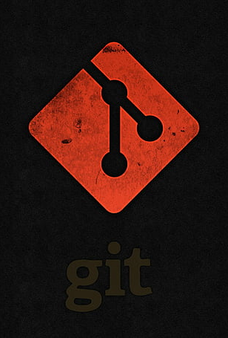
So you want to become a…
Today’s focus: integrating Git and RStudio for reproducible research
Why it matters:
Track code & data changes
Collaborate effectively
Ensure analysis reproducibility
You will become a Git Expert guaranteed😃🌈

Slide 3
By way of INTRODUCTION

Slide 4
TOY EXAMPLE

Slide 5
Ask not what you can do for version control…
project_final/
├── script_final.R
├── script_final_v2.R
├── script_final_v2_backup.R
├── data.csv
├── data_old.csv
├── results_final.xlsx
├── results_final_v2.xlsx
├── notes.txt
├── notes_updated.txt
bioinformatics-project/
├── data/
│ └── raw_data.csv
├── scripts/
│ └── analysis.R
├── results/
│ └── summary_table.csv
├── README.md
├── .gitignore
├── .Rproj
❌ Hard to tell which file is the latest ❌ No history of changes ❌ Risk of overwriting important work
✅ Clear structure ✅ Version history with Git ✅ Easy collaboration and reproducibility
Notes:
Complex workflows: Multiple scripts, data files, and collaborators
Reproducibility crisis: Difficulty replicating results without proper tracking
Data integrity: Risk of overwriting or losing important files
Collaboration hurdles: Conflicting edits, unclear file versions
Documentation gaps: Lack of clear history of changes

Slide 6
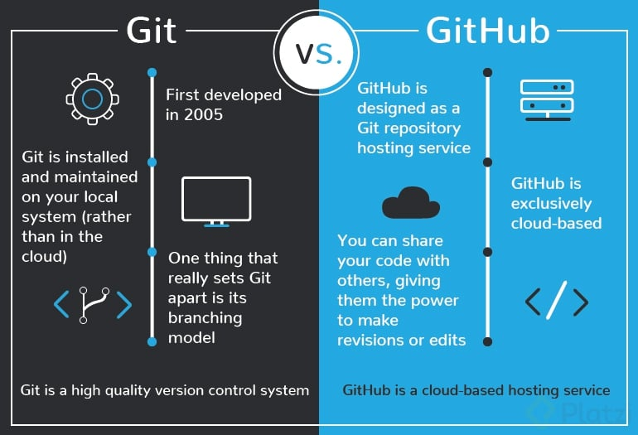
Git and Github Is R the same as Rstudio?

Slide 7
Understanding Git: A Version Control System
[Init] ---> [Commit 1] ---> [Commit 2] ---> [Commit 3] ---> [Commit 4]
Start Added script Cleaned code Added plot Finalized report
Tracks changes in files over time via snapshots (“commits”)
Allows you to:
Revert to previous versions
Work on different features in parallel
Collaborate w/o overwriting someone’s work
Used widely in software development and data science
Notes:
Time machine

Slide 8

GitHub: A Platform for Sharing and Collaboration
Web-based platform for hosting Git repositories
Enables:
Remote backup of projects
Collaboration - pull requests, issues
Sharing code & docs publicly or privately
Commonly used in research to:
Share analysis pipelines
Publish reproducible code
Track contributions in teams
Notes:
Emphasize that GitHub is not Git itself—it’s a service built on top of Git

Slide 9
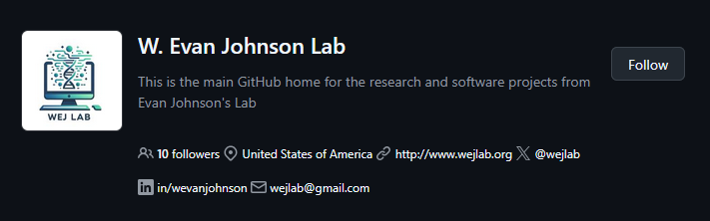
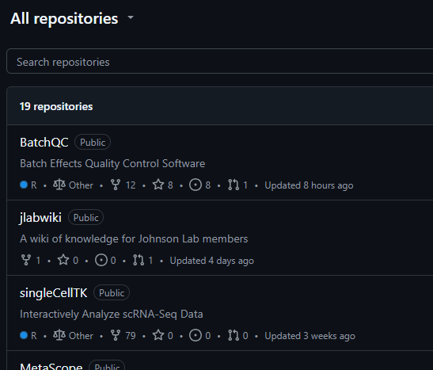
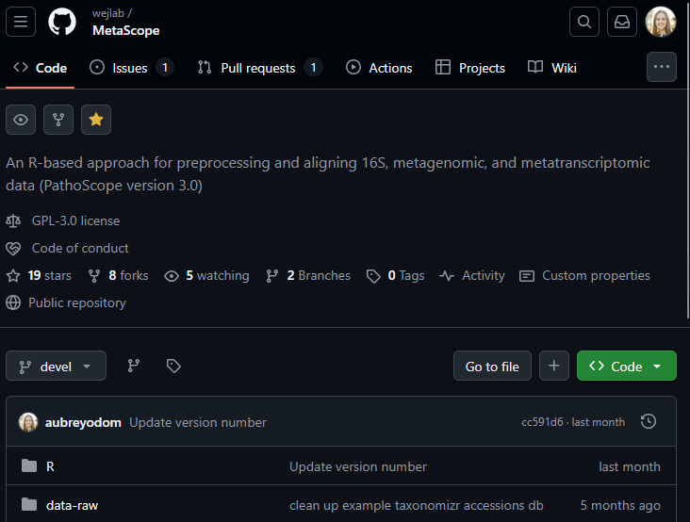

Slide 10
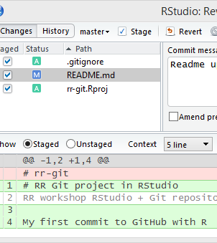
RStudio: Your IDE for R and Git Integration
Integrated Development Environment (IDE) for R
Provides tools for:
Writing/running scripts
RMarkdown reports
Managing projects & files
Built-in support for Git version control
Notes:
RStudio makes it easier to use Git without needing the command line

Slide 11
The Integration Workflow
[RStudio] ⇄ [Git] ⇄ [GitHub]
Git tracks changes to your project locally
GitHub stores your project remotely and enables collaboration
RStudio provides a user-friendly interface to manage both
Write code in RStudio
Use Git to commit changes
Push to GitHub to back up and share
Pull updates from collaborators
Typical workflow:

Slide 12
Setting up your ENVIRONMENT

Slide 13
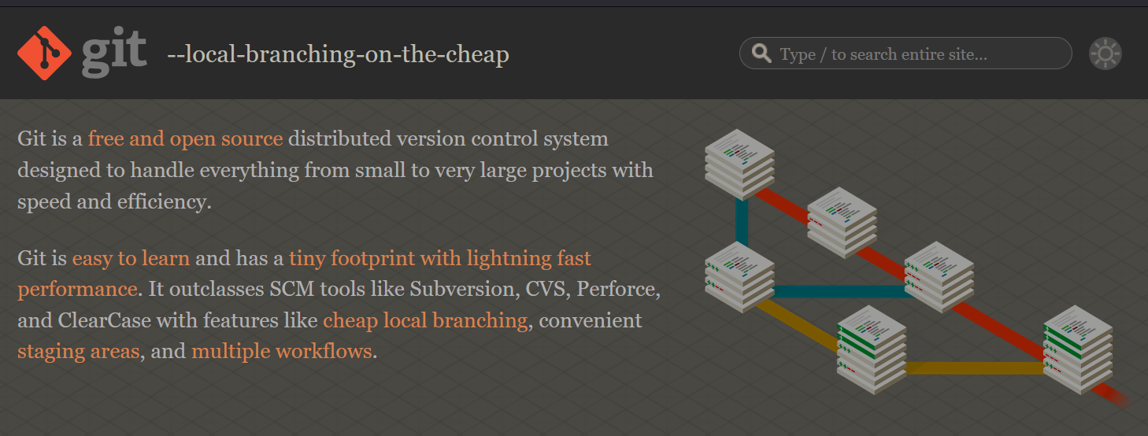

Step 1: Install Git
https://git-scm.com
After installation, verify:
git --version
Tips:
On Windows, Git Bash will be installed
On macOS, Git may already be installed or can be installed via Homebrew

Slide 14
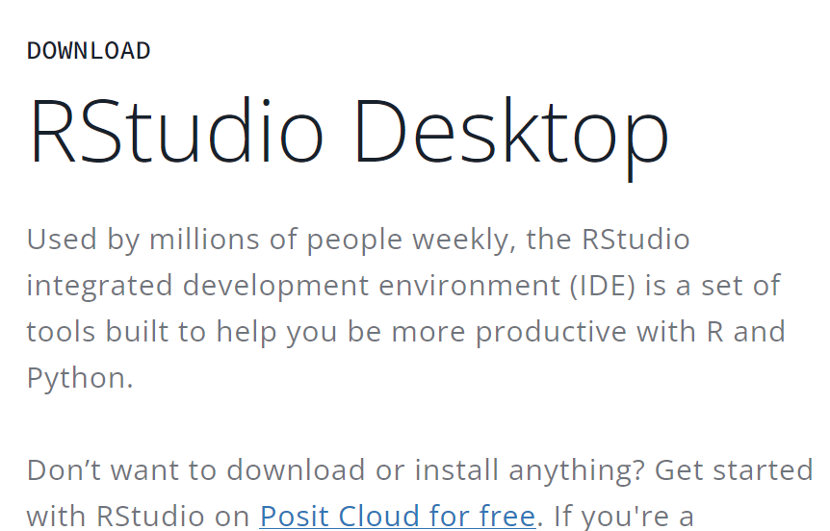
Step 2: Install R and RStudio
https://posit.co/download/rstudio-desktop/
** assuming you have already downloaded R from https://cran.r-project.org

Slide 15

Step 3: Set Up Your GitHub Account
Go to https://github.com
Click Sign Up and follow the steps:
Choose a username
Enter your email and password
Verify your account
After setup:
Add a profile picture and bio
Set your email visibility and notification preferences

Slide 16
Step 4: Set Your Identity in Git
Git needs to know who you are to associate your commits with your name and email.
Run these commands in the terminal:
git config --global user.name "Your Name“
git config --global user.email "you@example.com"
Note:
--global applies the settings to all Git repositories on your system.
Use your name and the email associated with your GitHub account.

Slide 17
Step 5: Authenticate Securely with GitHub
SSH keys allow you to connect to GitHub without entering your username and password every time.
SSH setup is a one-time process per machine.
Generate a New SSH Key:
ssh-keygen -t ed25519 -C "you@example.com"
Press Enter to accept the default file location.
Set a passphrase (optional but recommended).

Slide 18
Step 5 cont.
Add Your SSH Key to GitHub:
1. Copy your public key:
cat ~/.ssh/id_ed25519.pub
2. Go to GitHub → Settings → SSH and GPG keys → New SSH key
3. Paste the key and save.
4. Use ssh -T git@github.com to test your connection.

Slide 19
Git BASICS

Slide 20
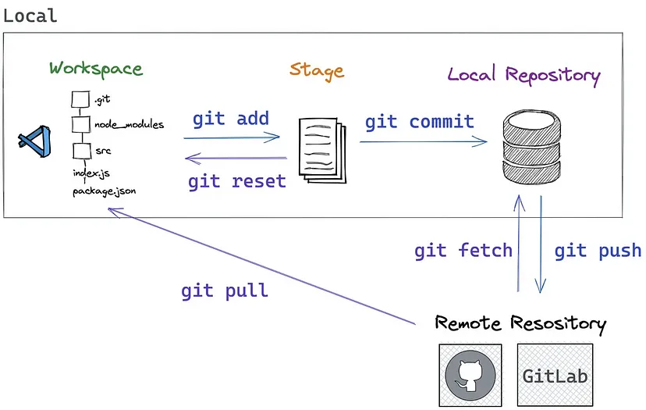
Mina Samir on Medium

Slide 21
Key Git Terms to Know
Repository (repo): A project folder tracked by Git
Commit: A snapshot of your project at a specific point in time
Staging area: Where changes are prepared before committing
Branch: A parallel version of your project for testing or new features
Merge: Combining changes from one branch into another
Remote: A version of your repo hosted online (e.g., on GitHub)
Clone: A copy of a remote repo on your local machine
Push/Pull: Send changes to or fetch updates from a remote repo
$ git init
$ git commit –m “initial commit”
$ git add --all
$ git branch main
$ git pull origin main
$ git push origin main
$ git merge
$ git remote -v
$ git clone https://github.com/wejlab/animalcules

Slide 22
Step 4: Start a Git-Tracked Project Locally
Navigate to your project folder in the terminal.
Run the command: git init
This creates a hidden .git/ folder that tracks changes
Your folder is now a Git repository
Example:
$ mkdir bioinfo-project
$ cd bioinfo-project
$ git init
Initialized empty Git repository in bioinfo-project/.git/

Slide 23
Step 5: Save Your Work with Commits
Git tracks changes in two steps:
Stage the files you want to include:
git add filename.R
Commit the staged changes with a message:
git commit -m "Initial analysis script"
Tips:
Use clear, descriptive commit messages
You can stage all changes with:
git add .
git add --all

Slide 24
Check What’s Happening in Your Git Repo
Use git status to see:
Which files are staged, modified, or untracked
Helpful reminders for next steps
Use git log to view commit history:
Shows commit messages, authors, and timestamps
Example Output:
commit 1a2b3c4d
Author: Your Name <you@example.com>
Date: 2025-06-03
Initial analysis script

Slide 25
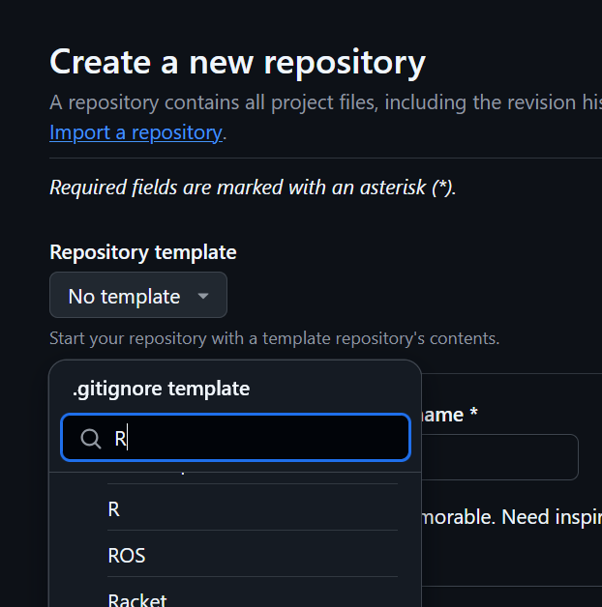
Keep Your Repo Clean with .gitignore
Use a .gitignore file to tell Git which files/folders to ignore
Common examples in bioinformatics:
Large raw data files (*.fastq, *.bam)
Temporary files (*.Rhistory, *.RData)
Output folders (/results/, /tmp/)
Example .gitignore:
*.Rhistory
*.RData
data/raw/
results/
Notes:
Helps keep your repo lightweight and focused on code
Emphasize that .gitignore prevents accidental commits of large or sensitive files

Slide 26

Fix Mistakes Without Fear Your changes can (almost) always be reversed!
Git lets you undo changes safely:
Unstage a file (remove from staging area):
git reset filename.R
Discard changes in a file (revert to last commit):
git checkout -- filename.R
Undo a commit (keep changes, remove commit):
git reset --soft HEAD~1
Use git status before and after to see what changed

Slide 27
Work on Features Without Breaking Your Main Code
Branching lets you create a separate line of development:
git branch new-feature git checkout new-feature
Make changes safely without affecting the main branch
Merging brings changes back into the main branch:
git checkout main git merge new-feature
Tips:
Use branches for new features, experiments, or bug fixes
Resolve any merge conflicts manually if they occur

Slide 28
Copy a Project from GitHub to Your Computer
Cloning creates a local copy of a GitHub repository:
git clone https://github.com/wejlab/animalcules
This sets up:
A local Git repo
A connection to the remote GitHub repo
You can now edit, commit, push, and pull!

Slide 29
GitHub INTEGRATION

Slide 30
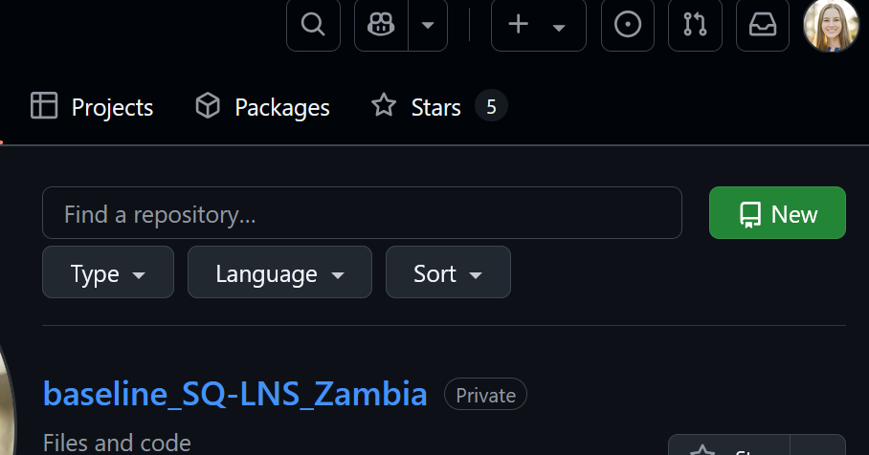
Creating a GitHub Repo via Web GUI
Let’s go make a GitHub repository!! [Walkthrough]
https://github.com/aubreyodom?tab=repositories
Notes:
Go to github and walk through this

Slide 31
Creating a GitHub Repo via Web GUI (steps)
Log in to GitHub
Click the “New“ button in the top-right corner → "New repository"
Name your repository (e.g., my-project)
Optionally:
Add a description
Choose public or private
Initialize with a README (recommended)
Add a .gitignore
Choose a license (e.g., MIT, GPL)

Slide 32
Connecting a Local Repo to GitHub
Goal: Link your local project folder (repo) to a remote GitHub repository so you can sync changes.
Create a local Git repository (if not already done):
git init
Add the remote GitHub repository:
git remote add origin https://github.com/your-username/your-repo.git
Push your local code to GitHub:
git push –u origin main
-u sets the upstream so future git push/pull commands know where to go.
Replace main with your branch name if different.
NOTE: Make sure your local repo has at least one commit before pushing, or GitHub will reject the push

Slide 33
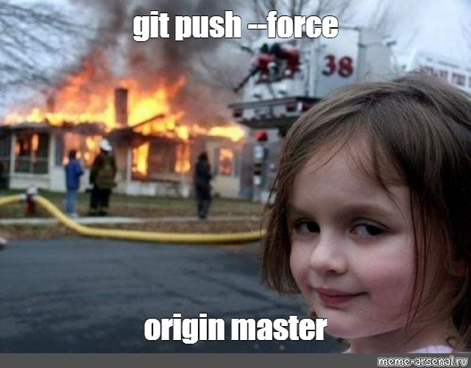
Pushing and Pulling to keep local + remote repos in sync
⬆️ git push
Sends your local commits to GitHub repo
Use after making commits locally.
Sends changes to the branch you're tracking (e.g., main or dev).
⬇️ git pull
Fetches and merges changes from the remote repository into your local repo.
Use before starting new work to avoid conflicts.
Combines git fetch + git merge.
Best Practice:
Always git pull before you start working and git push after you commit changes.

Slide 34
Forking and Pull Requests (PRs) The key to open-source collaboration
🍴 Forking a Repository
Creates a personal copy of someone else's repo under your GitHub account.
You can freely experiment without affecting the original project.
Steps:
Click "Fork" on the original repo page.
Clone your fork locally:
git clone https://github.com/your-username/forked-repo.git

Slide 35
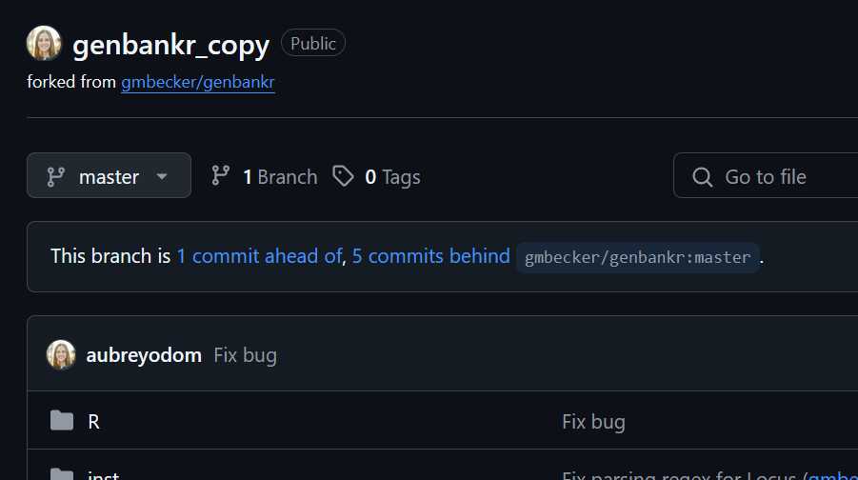
Example: Forked repository

Slide 36
Forking and Pull Requests (PRs) The key to open-source collaboration (cont.)
🔁 Making a Pull Request
After making changes in your fork, you can propose them to the original repo.
Keep your fork updated by syncing with the original repo regularly.
Steps:
Push your changes to your fork.
Go to your repo on GitHub and click "New Pull Request".
Describe your changes and submit the PR.

Slide 37
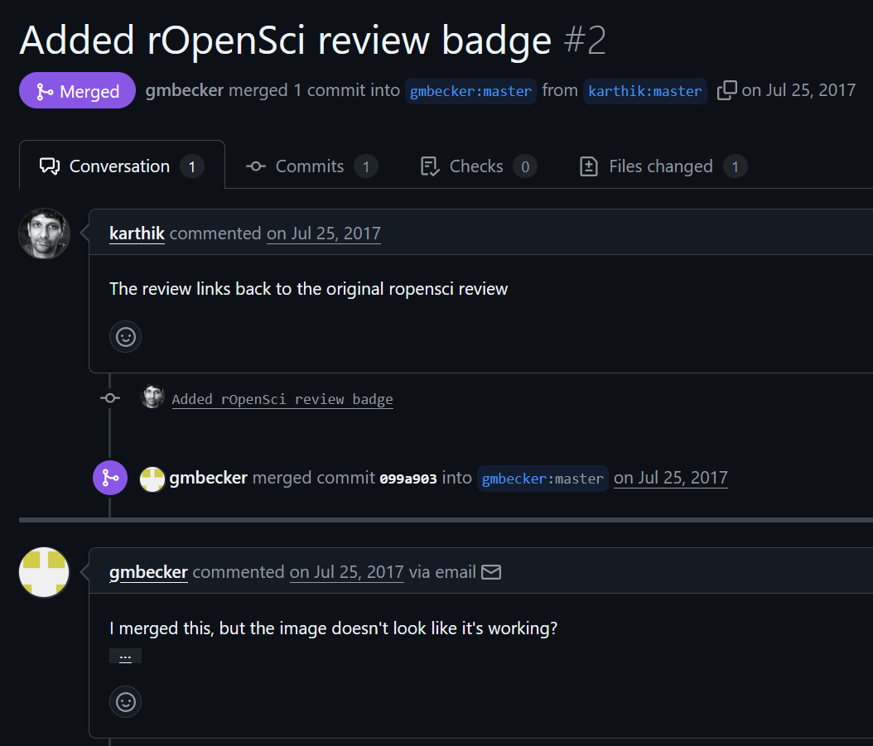
Example: Merged PR with comments

Slide 38
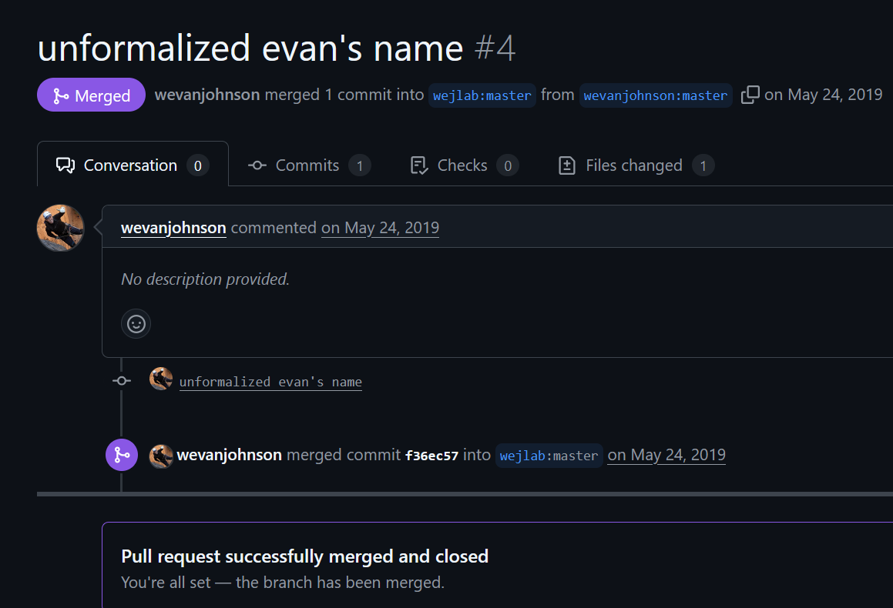
Example: Merging your own branch into the main branch

Slide 39
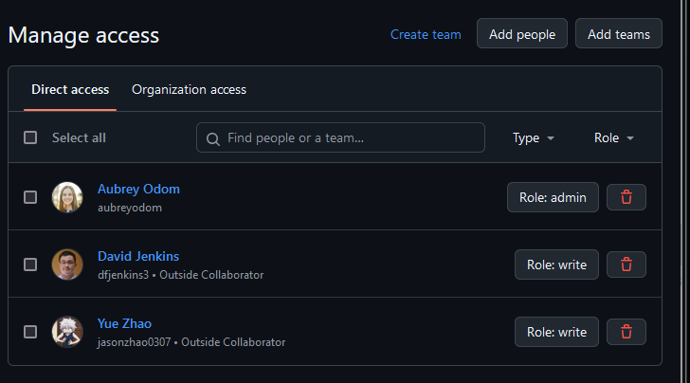
Collaborating on GitHub 🤝
🛠️ Issues
Track bugs, enhancements, and tasks
Assign team members, add labels, and set milestones
💬 Discussions
Open-ended conversations outside of code
Community engagement with developers
🔍 Code Reviews
Review changes via PR
Leave comments, suggest edits, and approve or request changes

Slide 40
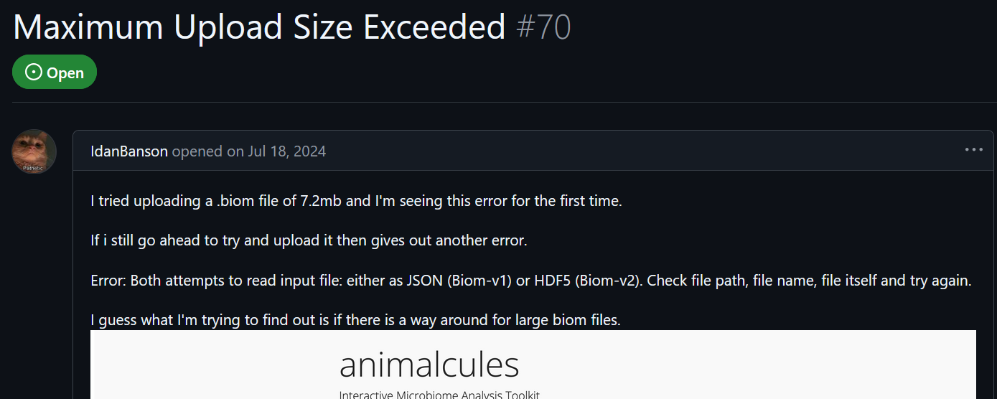
Issue example – animalcules

Slide 41
Rstudio INTEGRATION

Slide 42
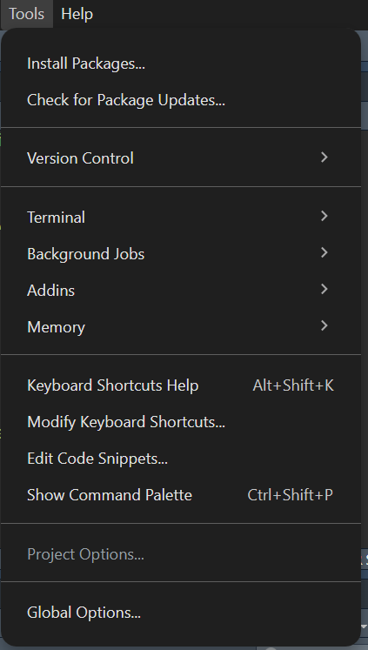
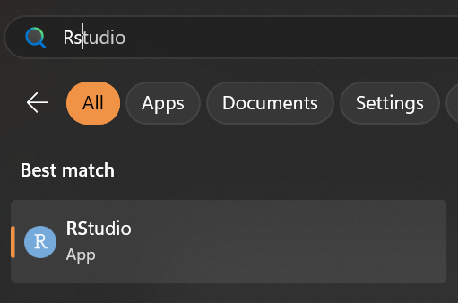
Enabling Git in RStudio
1. Open RStudio
2. Go to Tools > Global Options.

Slide 43
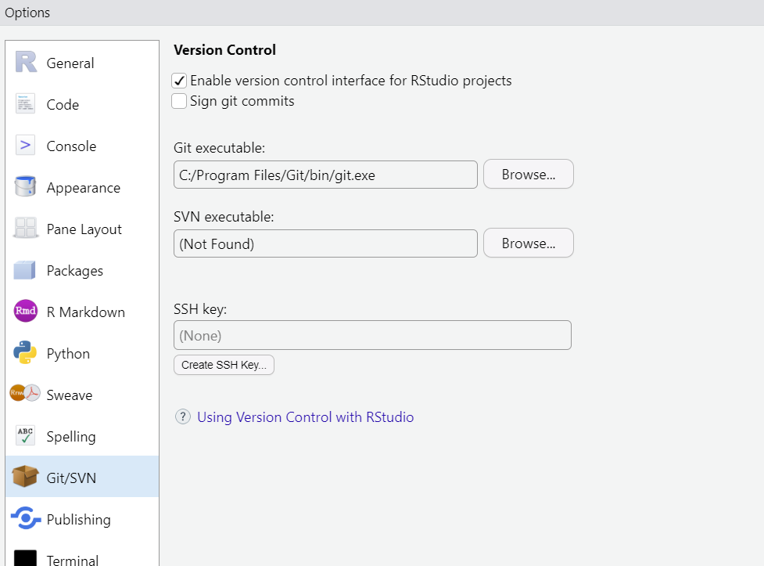
Enabling Git in Rstudio (cont.)
3. Select the Git/SVN tab.
4. Check the box: "Enable version control interface for RStudio projects".
5. Make sure the Git executable is detected (e.g., git.exe or /usr/bin/git).
🛠️ Troubleshooting
If Git is not detected:
Install Git from git-scm.com
Restart RStudio after installation

Slide 44
Creating a New Project with Git in RStudio
I have a new project! No GitHub repo exists, but I want to at least start a local repo and track my changes.

Slide 45
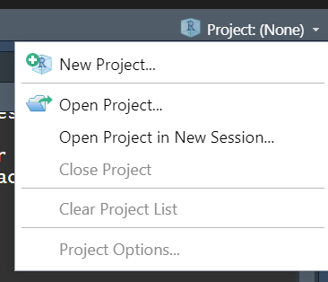
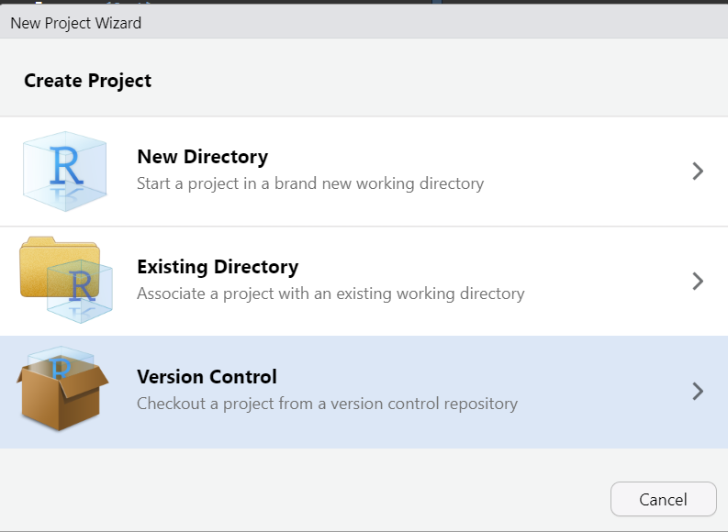
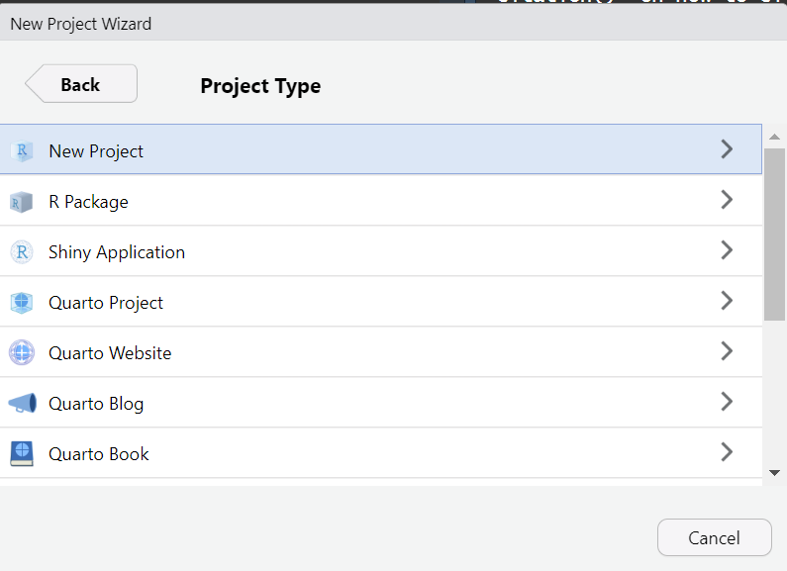
Creating a New Project with Git in RStudio
Go to Project -> New Project
(upper-right corner of RStudio)
2. Choose New or Existing directory
3. Choose New Project

Slide 46
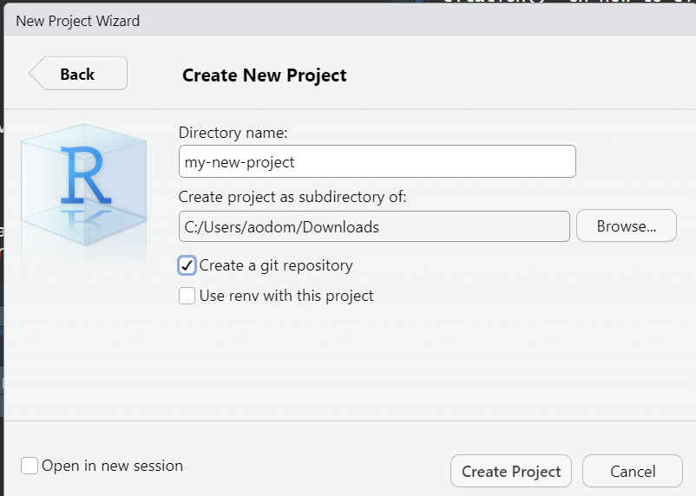
Creating a New Project with Git in RStudio
4. Name your project and choose a location
5. Check the box: “Create a git repository”
6. Create Project

Slide 47
Cloning from GitHub in RStudio
I have a new project! I made a GitHub repo and want to link it to that.

Slide 48
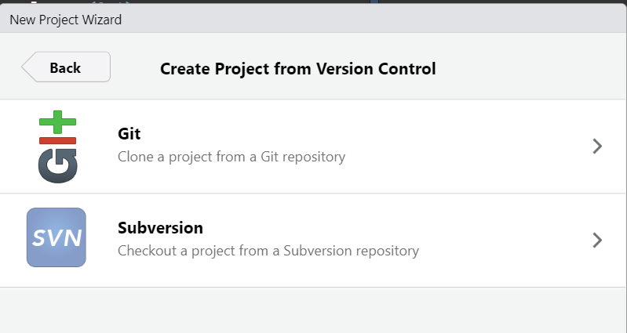
Cloning from GitHub in RStudio
Go to Project -> New Project
(upper-right corner of RStudio)
2. Choose Version Control
3. Select Git

Slide 49
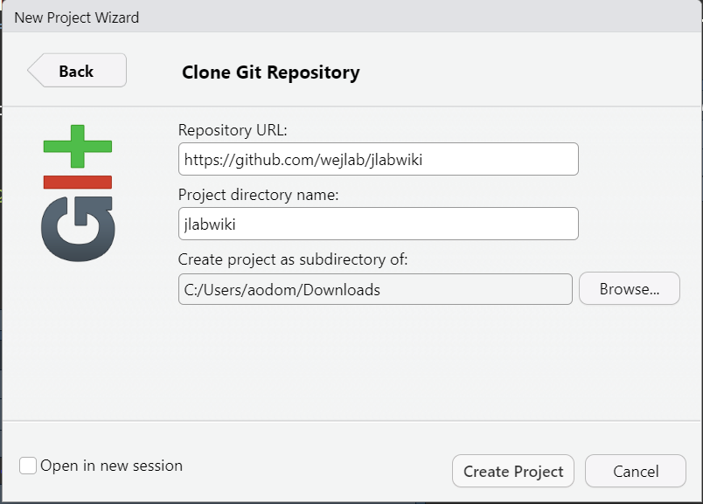
Cloning from GitHub in RStudio (cont.)
4. Paste the URL of your GitHub repository
5. Choose a local directory to clone the repo into
6. Click Create Project

Slide 50
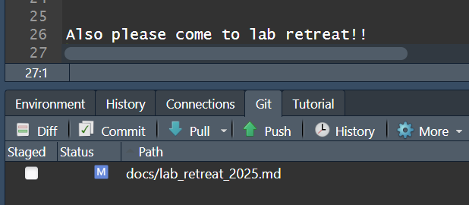
Cloning from GitHub in Rstudio (cont.)
🛠️ What Happens:
RStudio clones the GitHub repo to your computer
Opens the project in a new RStudio session (if option chosen)
Git pane appears for version control tasks

Slide 51
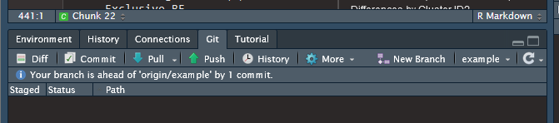
RStudio Git Pane Overview A user-friendly GUI for version control
Commit View, select files to commit. Opens a window to stage changes, write commit messages, and finalize commits.
Diff See line-by-line changes in modified files. Helps you review edits before committing.
History View the commit history for the project.
Pull / Push Buttons Sync changes with the remote GitHub repository.

Slide 52
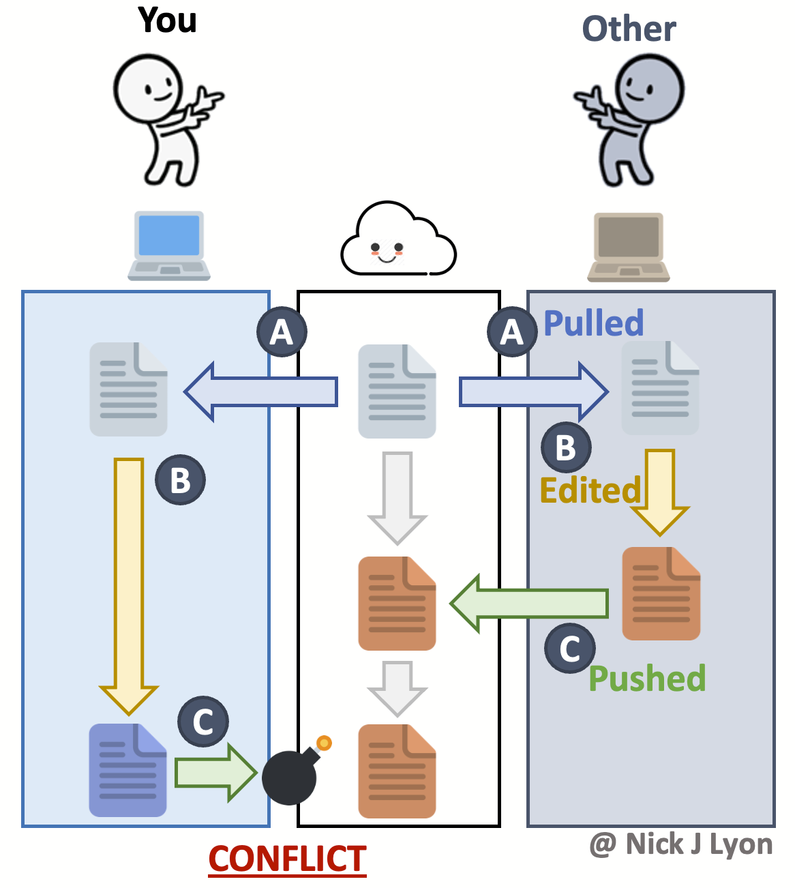
Handling Merge Conflicts
Merge conflicts happen when Git can’t automatically combine changes from different sources.
Two people edit the same lines in a file
You edit a file locally that was also changed on GitHub
<<<<<<< HEAD
Your local changes
=======
Incoming changes from GitHub
>>>>>>> origin/main

Slide 53
Handling Merge Conflicts (cont.)
Conflict Markers
Git marks the conflicting sections in the file like this:
<<<<<<< HEAD
Your local changes
=======
Incoming changes from GitHub
>>>>>>> origin/main
🛠️ Manual Resolution
Open the file and review both versions
Edit the file to keep the correct content
Remove the conflict markers (<<<<<<<, =======, >>>>>>>)
Save the file
Stage and commit the resolved file

Slide 54
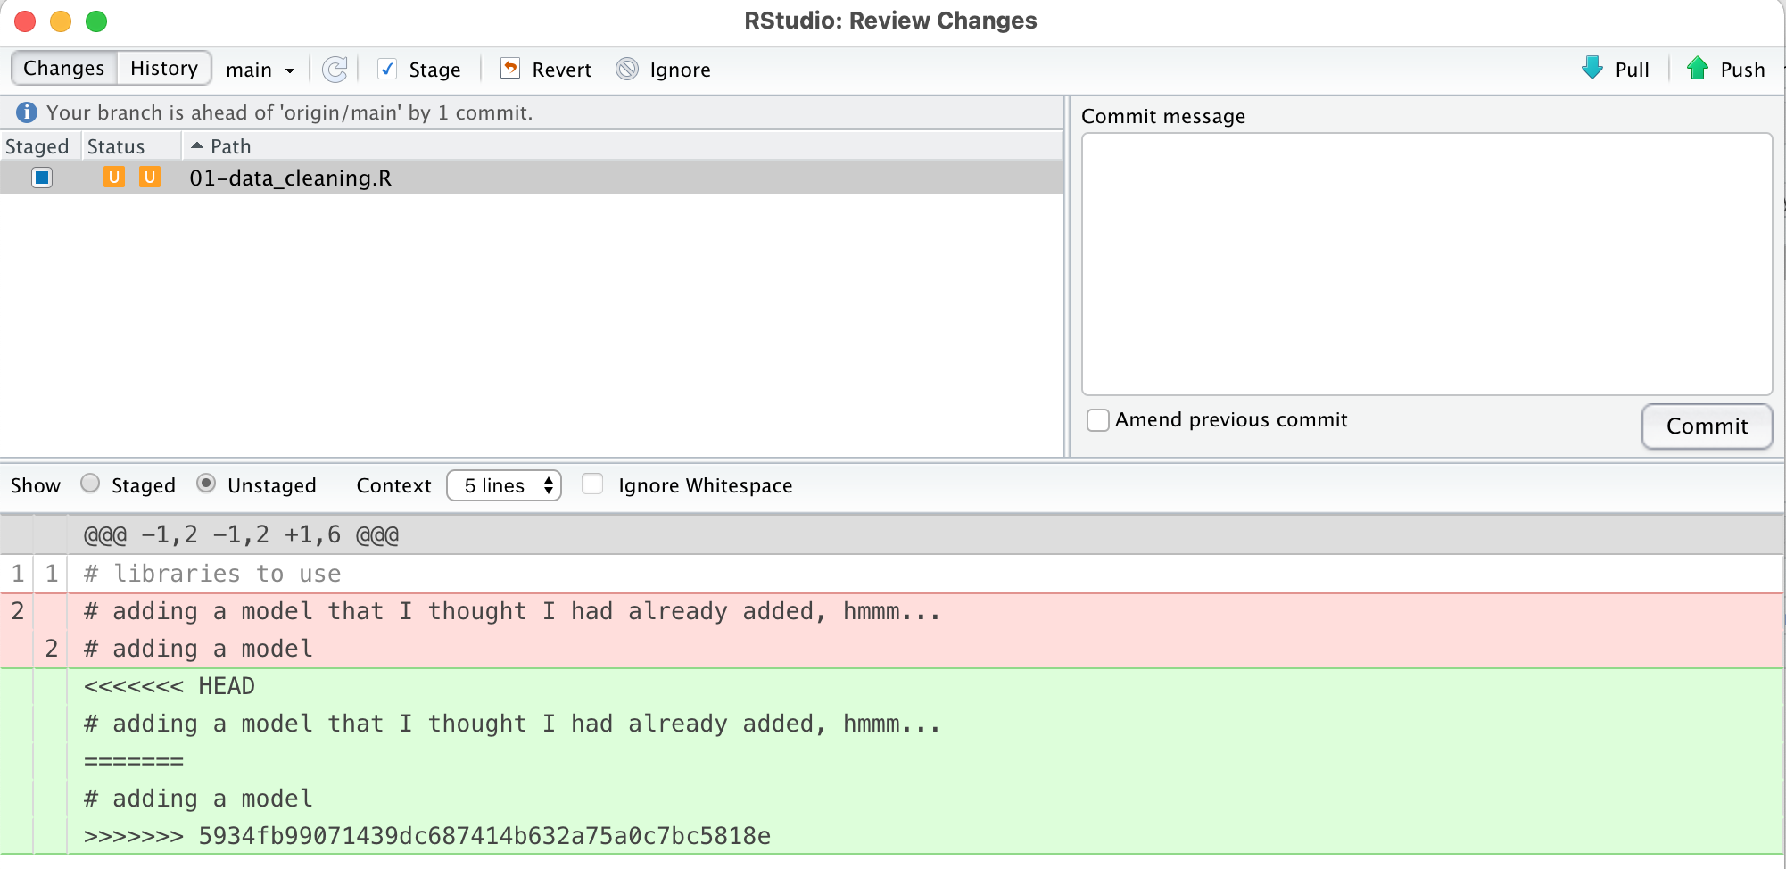
Handling Merge Conflicts (cont.)
RStudio’s diff viewer can help simplify conflict resolution.

Slide 55
Some Final TIPS

Slide 56
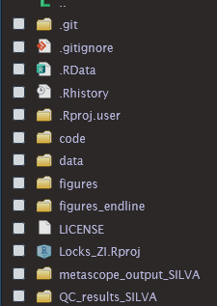
A Reasonable Project Structure
📁 Common Folder Structure:
data/ -- Raw and processed datasets.
scripts/ -- R scripts or notebooks for data processing; analysis
results/ -- Output files: plots, tables, and intermediate results.
docs/ -- Project documentation, reports, and README files.
Best Practices:
Use consistent naming conventions
Avoid storing large files in Git
Include a README.md to explain the project structure

Slide 57
Using usethis for Git Setup
🔧 Initialize Git in Your Project
usethis::use_git()
Sets up a local Git repository
Adds .gitignore and stages initial files
☁️ Connect to GitHub
usethis::use_github()
Creates a GitHub repo and pushes your local project
🛠️ Optional Helpers
use_readme_rmd()
Adds a README in R Markdown
use_git_config()
Set your Git username and email

Slide 58
Common Pitfalls and how to avoid them
⚠️ Merge Conflicts
Occur when multiple people edit the same lines of code.
Solution: Communicate with collaborators and pull frequently.
📦 Large Files
Git struggles with large datasets (e.g., raw sequencing files).
Solution: Use .gitignore to exclude large files or use Git LFS.
🔄 Sync Issues
Forgetting to pull before pushing can cause errors.
Solution: Always git pull before starting work and before pushing.

Slide 59
Burn It All Down Strategy 🔥🧯🐦‍🔥
Git history is too messy to untangle
Merge conflicts are overwhelming
Local repo is out of sync with GitHub
🧹 Steps to “Burn It Down” (Safely):
Backup any important local changes
Delete the local project folder
Re-clone the repository from GitHub:
git clone https://github.com/your-username/your-repo.git
Reopen the project in RStudio
This strategy is a last resort—but it’s often faster than debugging a broken Git state.

Slide 60

Summing it up
Git + RStudio = Reproducible, Collaborative Science
Track changes in your code, data, and documentation
Collaborate effectively with lab members and the wider research community
Ensure reproducibility by versioning every step of your analysis
Integrate seamlessly with RStudio for a smooth workflow
Share your work via GitHub for transparency and impact

Slide 61
RESOURCES
📘 Happy Git with R A friendly, R-focused guide to using Git and GitHub https://happygitwithr.com
📙 Pro Git Book Comprehensive and free book on Git fundamentals https://git-scm.com/book/en/v2
📄 GitHub Docs Official documentation for GitHub features and workflows https://docs.github.com/en/get-started
Also just use git all the time and you will learn very quickly OK
And ask ChatGPT every time you have an error
it will fix it
maybe

Slide 62
RESOURCES – from Jessica
How to install Git on any OS
https://github.com/git-guides/install-git
Set up Git
https://docs.github.com/en/get-started/git-basics/set-up-git

Slide 63

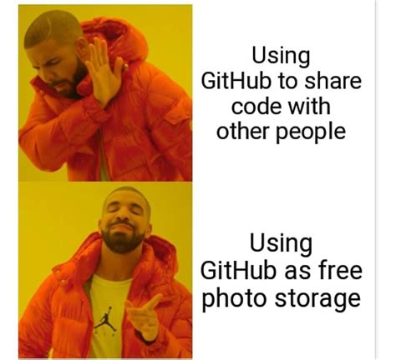
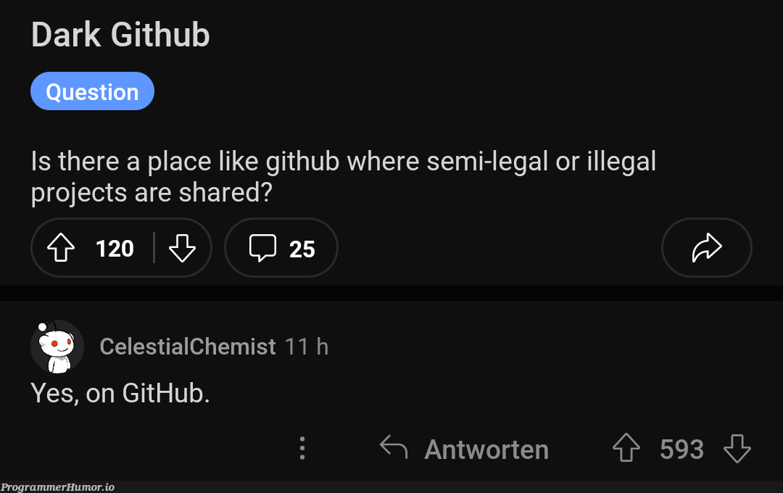

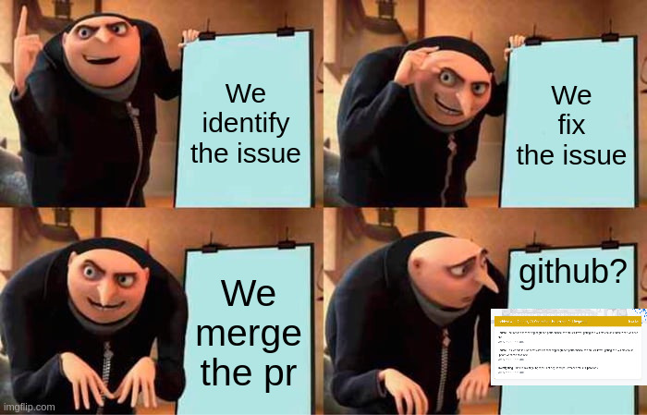

Q&A Time!

